Slide 2
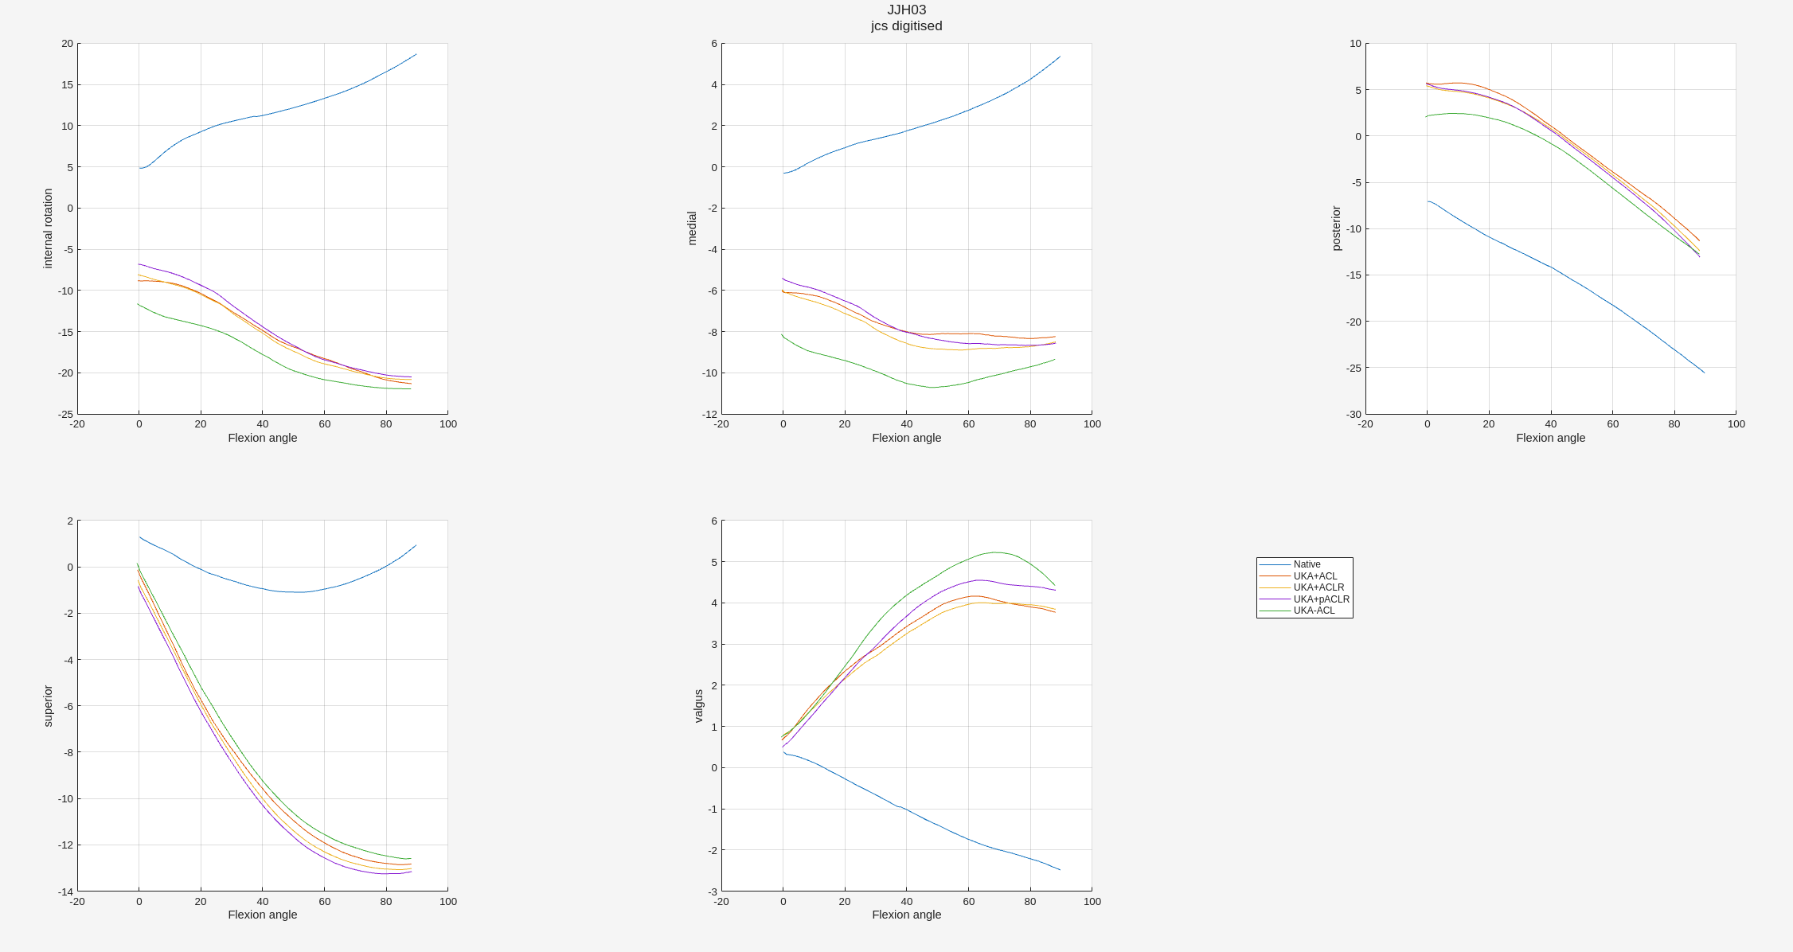

Slide 3
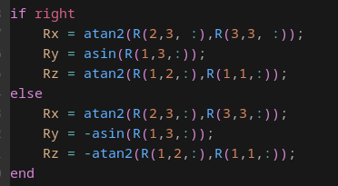
Sign changes for right/left
Right-handed
Right => left knee:
Ry, Rz opposite sign. Rx same sign

Slide 4
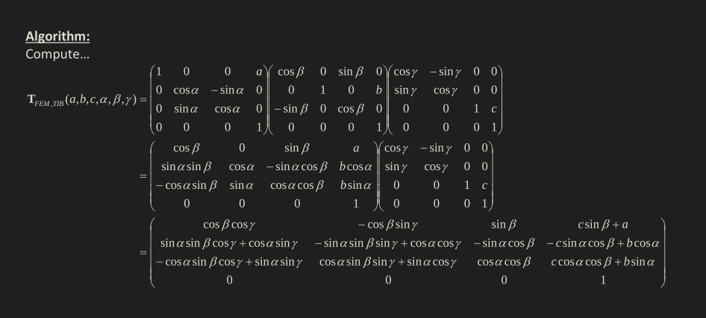
Definitions for a right knee
Ry
Ry
Rx

Slide 5
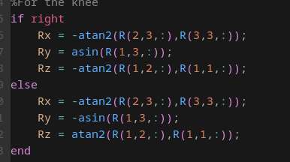
Left handed system
Right-handed system

Slide 6
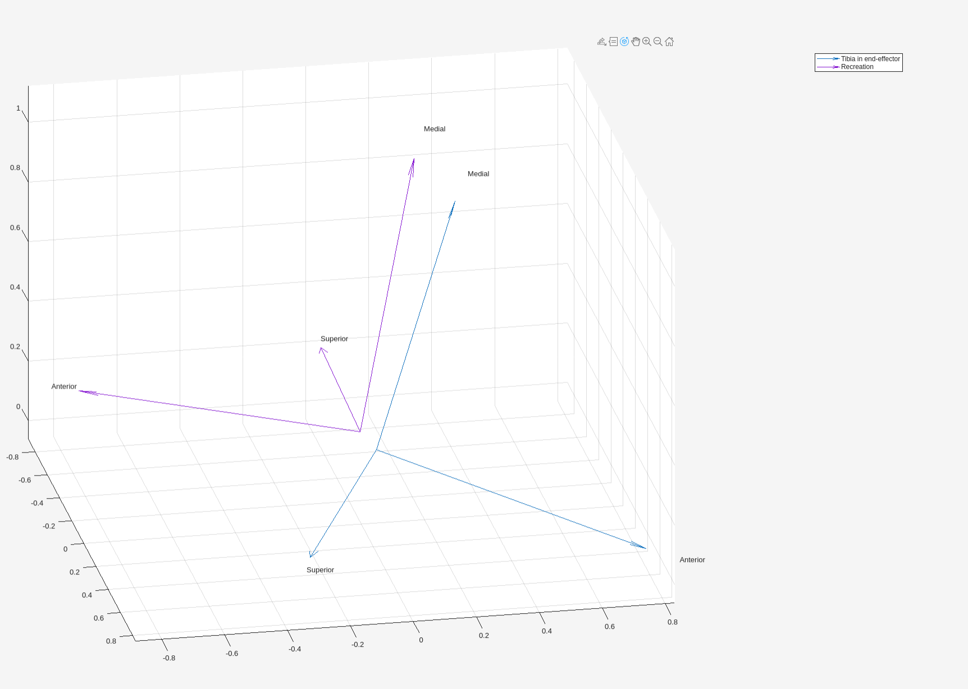
Corrections:
Robot position rotation have negative signs
Robot position converted from mm to m

Slide 7
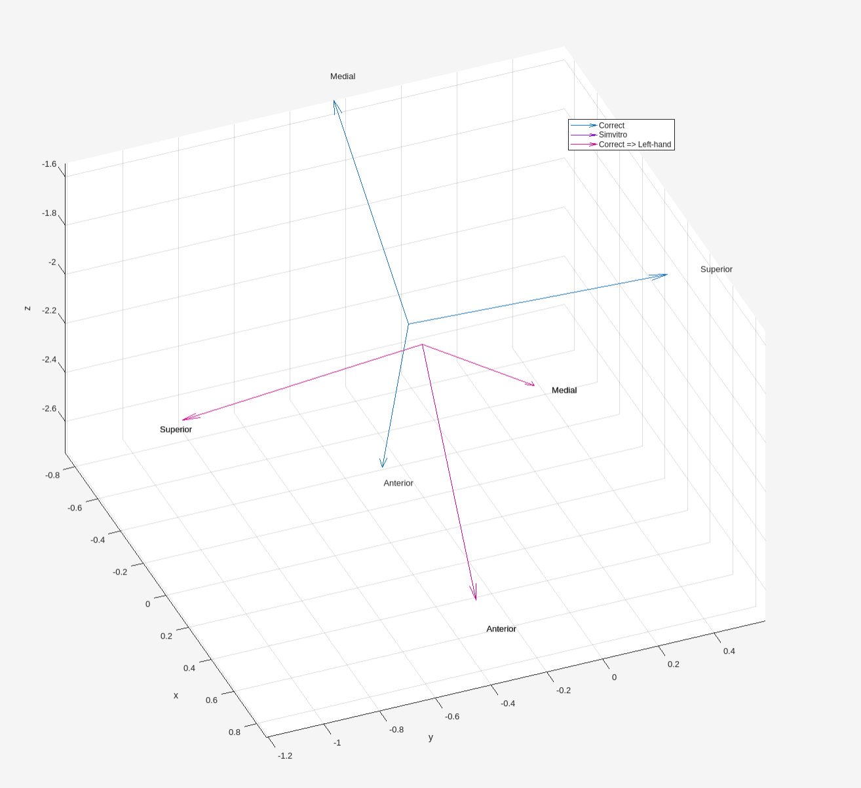
This is not a left-handed to right-handed symmetry
Left to right symmetry has all 3 rotated. Not a rotation about some odd axis

Slide 9
